Slide 2
Annual Champion Members Meeting for year 2020-22
Thursday, Dec 1, 2022
at 7:30 PM
at the Jame Masjid Guelph

Slide 3
AGENDA
Financial statement 2021-2022
Muhammed Sayyed
Updates of initiatives & projects 2020-22
Multiple Presenters
Meezan School Update
Omar Abdool
Fundraising / Donations updates
Saad Enouri

Slide 4
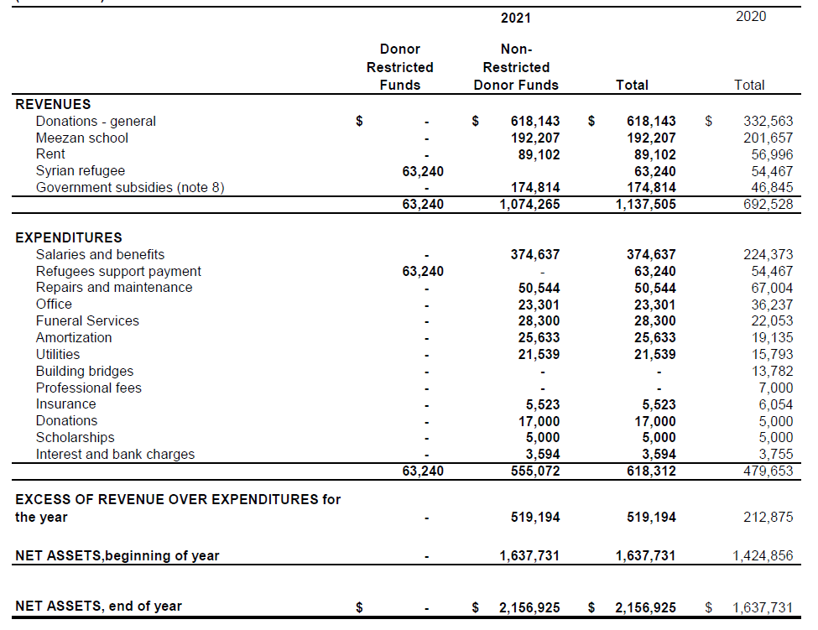
Financial Statement 2020-21
STATEMENT OF REVENUES AND EXPENDITURES AND CHANGES IN NET ASSETS

Slide 5
Project Overview Muhammed Sayyed
Building Permit issued
Demolition, excavation, footing and foundation completed
Underground services completed
Basement floor completed
Steel Structure for first and second floor installed
Gymnasium floor to be installed in Dec-2022

Slide 6
Project Overview
Roof and stairs to be installed in Dec-2022
Elevator to be installed in Jan/Feb-2023
Site walls framing to begin in Spring 2023
Site services for waterline and fire hydrant at the front parking – Spring 2023
Doors, Windows & Roof – Summer 2023

Slide 7
Project Overview
Project Team
Tariq Cheema, Civil Engineer
Tahir M. Chaudry, P. Eng. Mechanical
Arif Kidwai, P. Eng. Civil
Imam Mubeen Butt – Site Supervisor
Muhammed Sayyed – Project Manager

Slide 8
Project Overview Construction Timeline (Targets, Milestones, and Expenses)

Slide 9
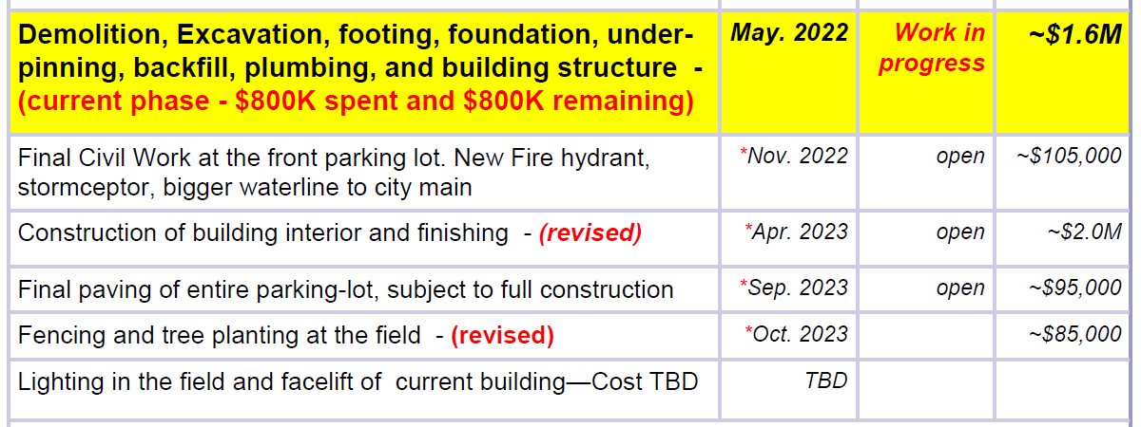
Project Overview Construction Timeline (Targets, Milestones, and Expenses)

Slide 10
Construction Phase III Arif Kidwai
Finishing of the building - TBD
Electrical, plumbing, washrooms
Prayer Hall finishing
Gymnasium finishing
Basement finishing
Mezzanine floor finishing
Exterior Walls finishing
Final grading of the parking lot - TBD

Slide 11
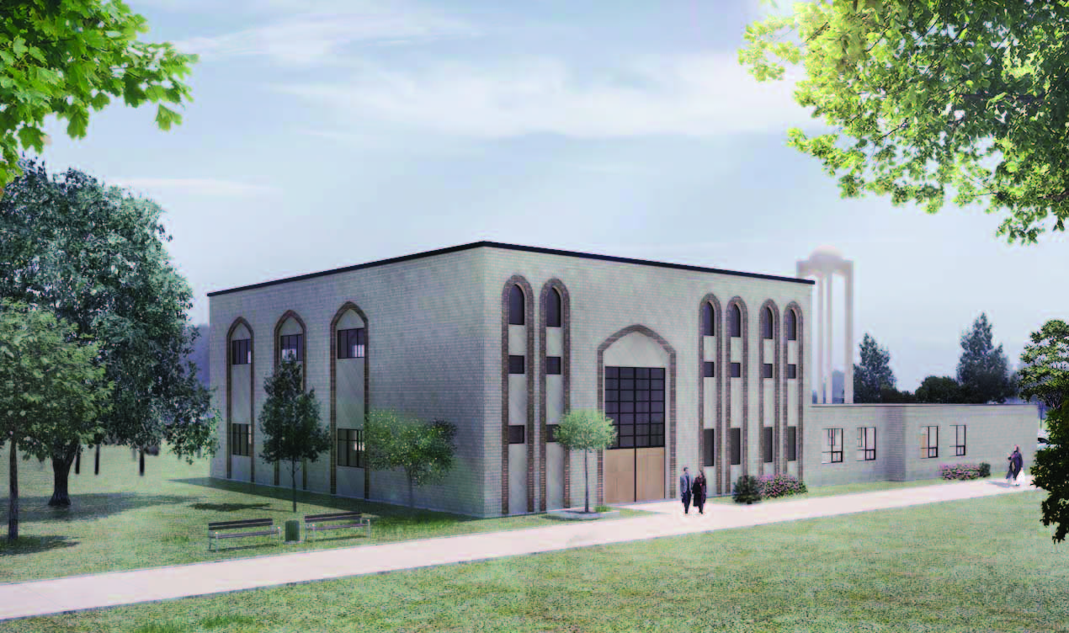
Drawings for the Project Building Plan

Slide 12
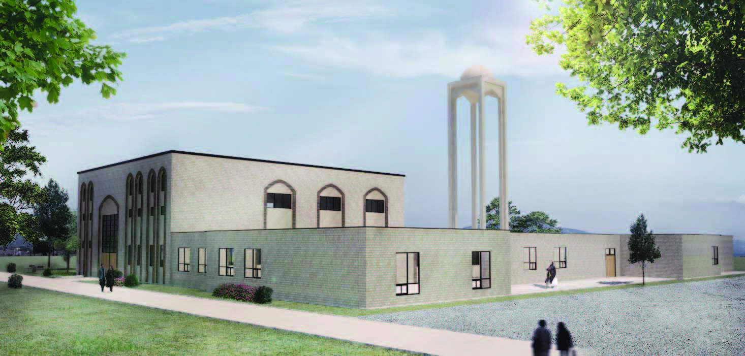
Drawings for the Project Building Plan

Slide 13
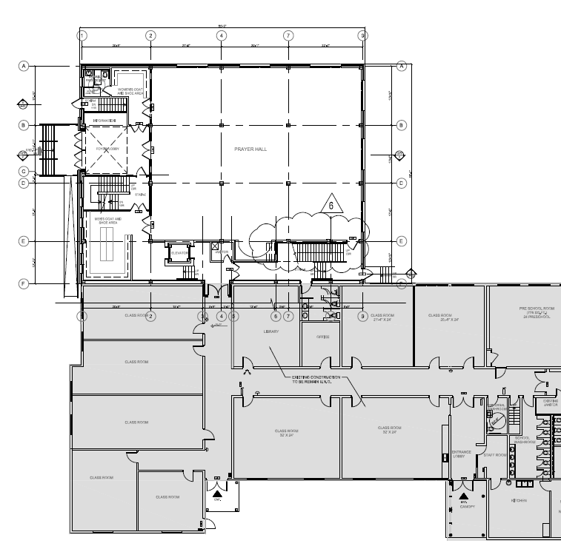
Drawings for the Project Full Overview

Slide 14
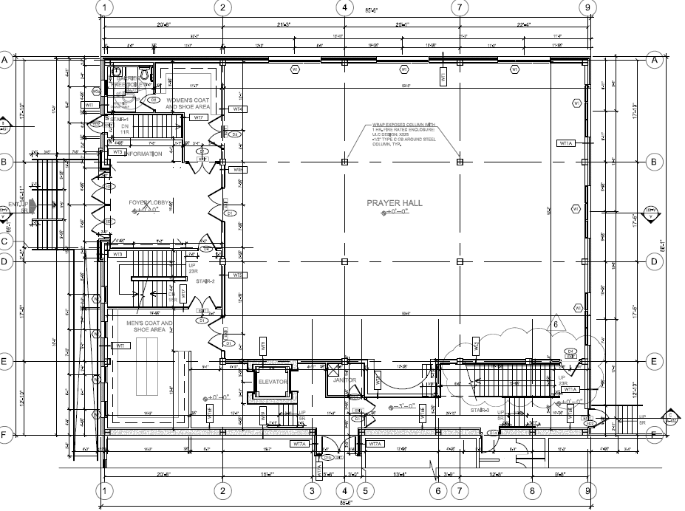
Drawings for the Project First Floor/Prayer Hall

Slide 15
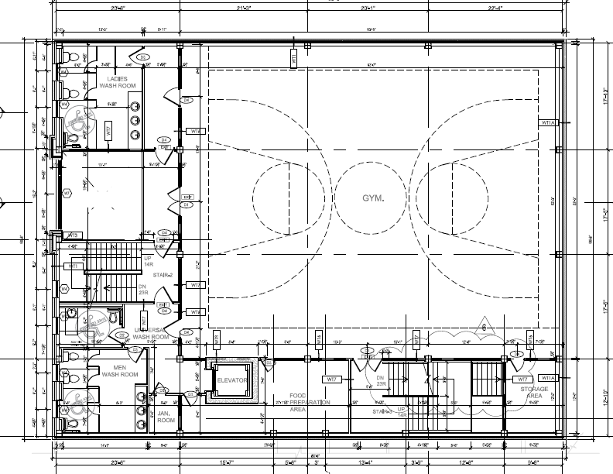
Drawings for the Project Second Floor/Gymnasium

Slide 16
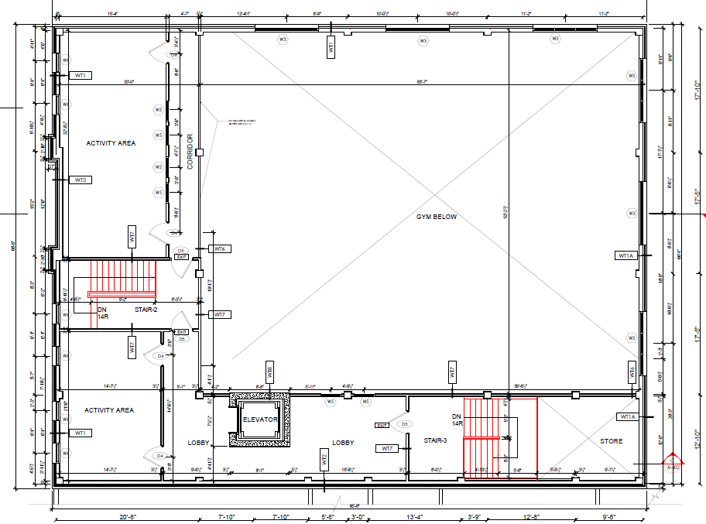
Drawings for the Project Mezzanine Floor/Community Rooms

Slide 17
Funds and Expenses Update Dr. Saad Enouri

Slide 18
Fundraising Update
$429,894.7
$401,352.00
$347,559.93
$308,629.27

Slide 19
Fundraising Update

Slide 20
Fundraising Update

Slide 21
Fundraising Update

Slide 22
Fundraising Update

Slide 23
Fundraising Update
Fund situation for the construction (fundraise update, pledges and collection)
InshaAllah there will be a fundraise event on Sunday, December 10, 2022, at Riverrun Centre
We have launched an online appeal for the funding via PayPal on our social media
Fridays are geared towards the reminder about the shortage of funds to complete the current phase of the project

Slide 24
Fundraising Update
Income and Expenses Quick Overview
Donations Received 2016-2022 $1,406,009.90
Engineering and Construction Expenses 2017-2020 ($1,336,255.78)
Total Cash-in-Hand as of April 30, 2020, @340,677.03
Upcoming Expenses to complete the current phase of the Project $800,000.00

Slide 25
Fundraising Update
OUR ASK
Attend the fundraising event on Dec 10
Reach out to your family & friends
Commit to raise $5000 for the masjid
Pray for the successful completion of new masjid project

Slide 26
Updates of events, initiatives
and
programs during COVID19
Muhammed Sayyed
Wasim Iqbal

Slide 27
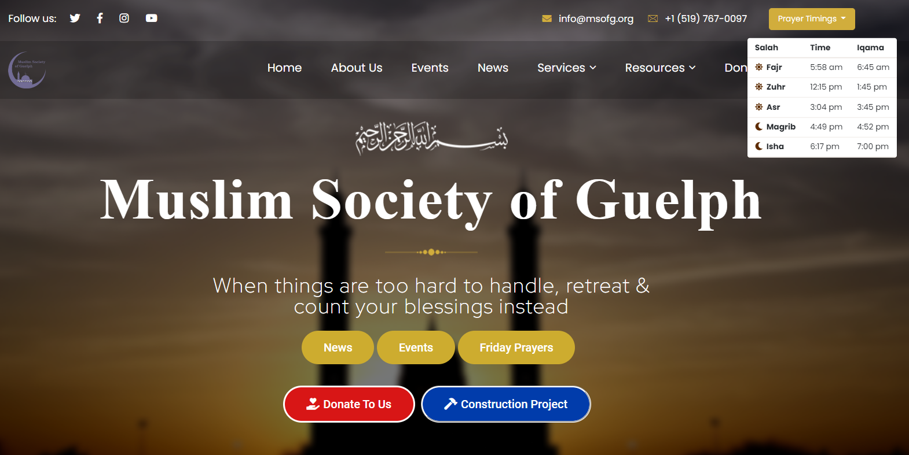
Events and initiatives
Newly designed Website to handle online registration and timely updates

Slide 28
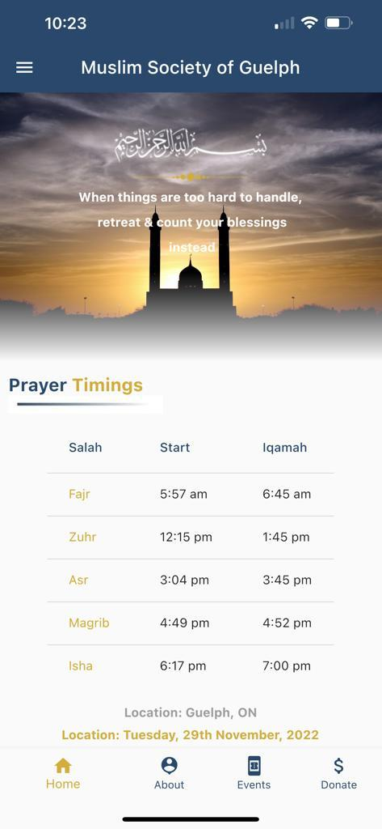
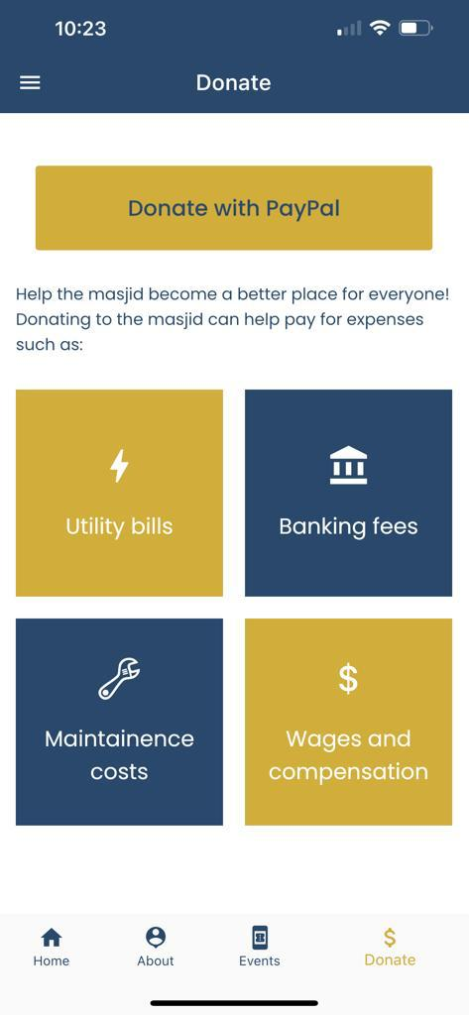
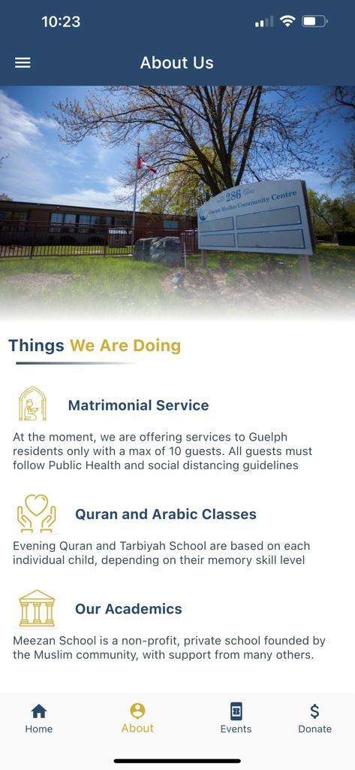
Events and initiatives
MSOG App for Apple & Android

Slide 29
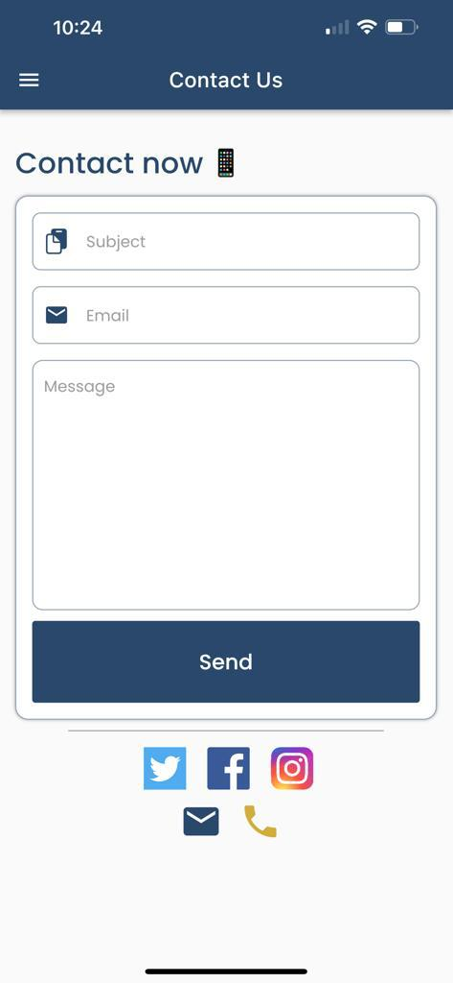
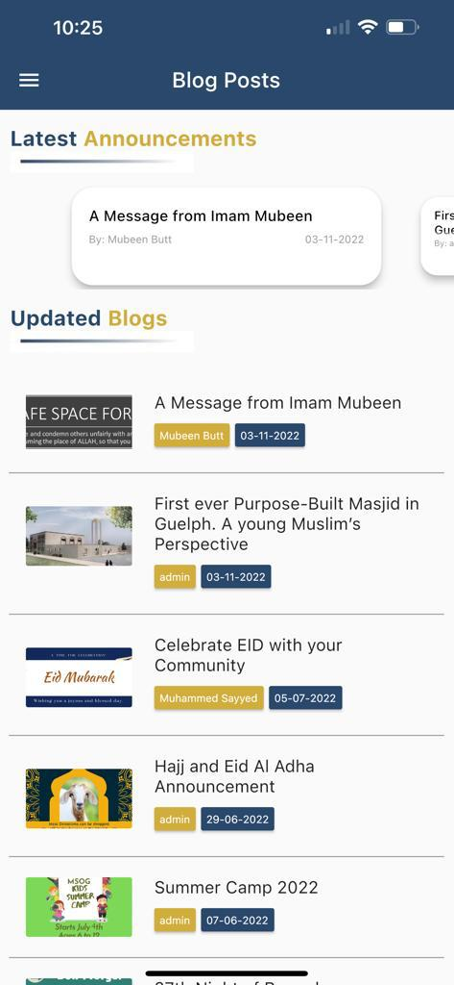
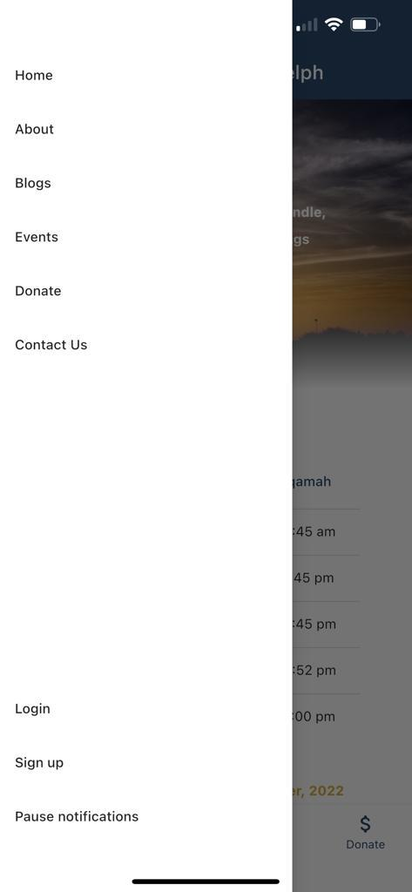
Events and initiatives
MSOG App for Apple & Android

Slide 30
Events, Initiatives, & Programs
Building Bridge event (Jan 2020): an important social event to engage with other communities and organization in Guelph and to recognize individuals who have made a great contribution to the community. “It is noteworthy that the Guelph Mercury described the MSOG as a "unifying force" within the City in response to the Society's first "Building Bridges" event held in December 2015 at the Hanlon Convention Centre”.
The event was held at the conference hall at Delta Hotel, Guelph with over 300 attendances from various communities and organization in Guelph.
Next to be held in Jan 2023 InshaAllah

Slide 31
Events, Initiatives, & Programs
Weekly Gymnasium for the Youth
MSOG has arranged John McCrea School for weekly youth activities
Monthly Youth Programs by Imam Mubeen
MSOG is holding monthly youth program with Imam Mubeen to address the challenges faced by our youth in this day n age.
Arabic Language program
MSOG has arranged a weekly Arabic learning program of children under the age of 14 for Arabic speaking children
Islam for Young Scholars
Weekend Islamic School for the children born in year 2014
Alqaeda al Noorani & Arabic Language
Friday and Saturday program for Arabic and learn essential duas and Quran for Non-Arabic speaking children

Slide 32
Events, Initiatives, & Programs
Islamic Studies and Quran Reading
MSOG is holding monthly youth program with Imam Mubeen to address the challenges faced by our youth in this day n age.
Girls Club
Girls club juniors and Girls club youth (50+ students)
Every Friday there is program girls organized by Dr. Nahla Saeed
Hifz Program by Imam Ibrahim Gangat
There is a daily hifz program for those who are interested
Meezan School
First Islamic School of Guelph operated by MSOG (Omar Abdool to give brief overview of the School)

Slide 33
Events, Initiatives, & Programs
Summer Camp (July to August 2022)
A successful summer camp managed by Imam Mubeen was held at MSOG facility.
Annual BBQ event (September 2022)
Included delicious food, entertainment and socializing activities. A great way to meet our neighbours who live around the Masjid. We had a great turnout from neighbors and larger community of Guelph, who were invited to join us.
Eid al Adah event (July 2022)
In addition to Eid Day Prayers and socializing we include an initiative of Halal meat donation to food bank, Lakeside Hope House, and Welcome drop-in Centre.
All these activities and events are self-funded or funded through sponsorship. No money is taken from masjid account.

Slide 34
Events, Initiatives, & Programs
Some other initiatives include but not limited to:
Host of condolence/ vigil event for London family.
Setting up anti-racism funds to tackle racism faced by Muslims.
Regular Multi-faith and school group visits to our facility.
Outreach to school board, as well as visiting schools resulting on Friday and daily prayers arrangement for high school student.
Sitting at the different boards of community agencies to represent Muslims perspective

Slide 35
Events, Initiatives, & Programs
Corporate Matching Gift Program
Corporate matching gifts are a type of philanthropy in which companies financially match donations that their employees make to nonprofit organizations. When an employee donates, they’ll request the matching gift from their employer, who then makes their own donation. Companies usually match donations at a 1:1 ratio, but some will match at a 2:1, 3:1, or even a 4:1 ratio

Slide 36
Events, Initiatives, & Programs
Grants, Donations, and Scholarships by MSOG
Guelph General Hospital
Hope House Guelph
Willow West Community Village
Food Bank of Guelph
Chalmers Guelph
University of Guelph
Wilfrid Laurier University
Upper Grand District School Board
Wellington County Catholic School Board
Your generous giving to The Foundation of Guelph General Hospital has now reached the Builder level of our Donor Wall. Thank you for your continued support.

Slide 37
Outcome & Results Dr. Farooq Ahmed
Events hosted by the MSOG have resulted in many requests for more information on Islam and invitations to join other local community organizations ensuring that the Muslim community has a greater voice and representation in social and political landscape. Our events are covered locally by media and promoted nationally and internationally. Local coverage ensures that we count as an important part of the city and decisions by city include our input. Media coverage by outlets like BBC and Al Jazeera show the Muslim community of Guelph as an important part of Canadian culture.

Slide 38
Outcome & Results
In response to Building Bridges event MSOG were invited for the following sessions/initiative;
Invitation from Guelph General Hospital to give feedback on meeting needs of Muslim patients
Wilfred Laurier University asking and offering services for inclusion and how to better their services
Upper Grand School Board asking for input on Inclusivity and Equity Policy for all schools.
Specific schools asking “how can we make Muslim Students feel safe and included in schools and for better understanding of Islam.”
Federal Government asking for input on various bills and motions being discussed or passed.
Provincial Parties asking for our involvement and input for policy.

Slide 39
Annual General Meeting for Champion Members for year 2022
THANK YOU for your participation
Thursday, December 1, 2022
Concluded at 8:00 pm
at the Jame Masjid Guelph

